Slide 1

Data-Driven Insights for Supermarket Sales - Churn Analysis
GROUP 3:
Prasanna Kumar
Lahari Nalabothu
DATA 5100 PROJECT

Slide 2
GOALS
The goal of this project is to gain a comprehensive understanding of customer behavior within a supermarket environment. The project aims to identify key factors influencing customer loyalty or churn. The ultimate objective is to optimize supermarket operations and enhance customer satisfaction.
UnderStanding Customer Behaviour: The project seeks to analyze and comprehend customers’ various actions and behaviors during their interactions with the supermarket. This includes the purchasing patterns, frequency of visits, and preferred products.
Identifying Factors Contributing to Loyalty or Churn: The project aims to identify and analyze the factors that contribute to customer loyalty or churn.
Increasing Revenue: The overarching goal is to contribute to the supermarket's bottom line by increasing revenue. This can be achieved through targeted efforts to retain loyal customers, attract new ones, and strategically position products and services based on customer preferences.

Slide 3

APPROACH
Data Cleaning and Preprocessing
Exploratory Data Analysis (EDA)
Correlation-based features analysis
ML-based important features detections
Frequent itemset mining
Recommendations
Clustering Insights

Slide 4
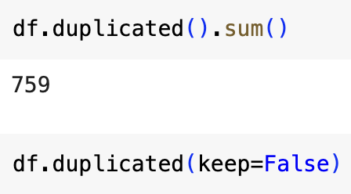

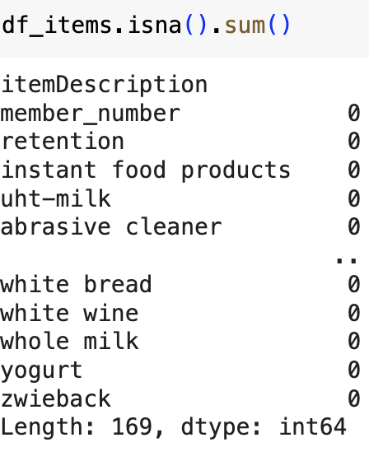
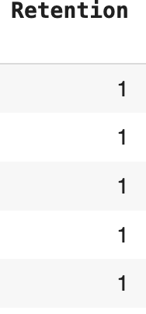
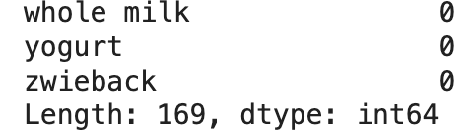
DATA CLEANING & PREPROCESSING
DATA SET
Super Market (Kaggle)
38,765 Values
Columns (Member_Number, Date, Item Description)
REMOVING
Removing Duplicates
HANDLING
Handling Missing Values
PREPARATION
Preparing Data
Calculating 'Retention' Column
RETENTION:
Determined customer retention by establishing a criterion where a customer is considered retained if they visited in more than one quarter.

Slide 5
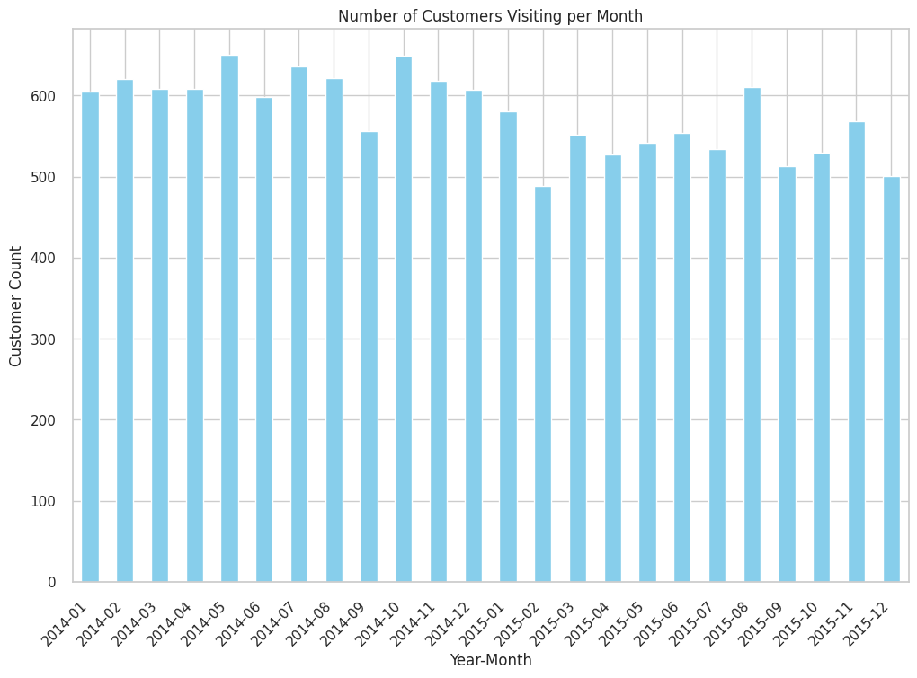
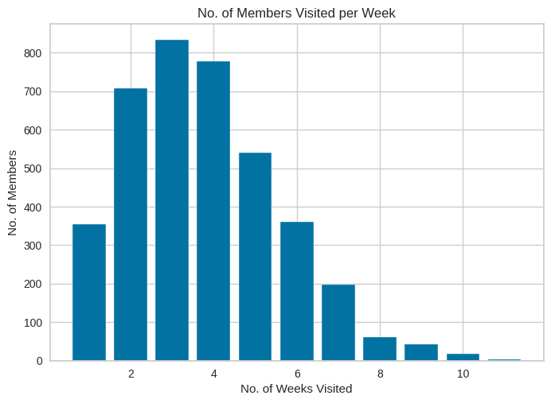
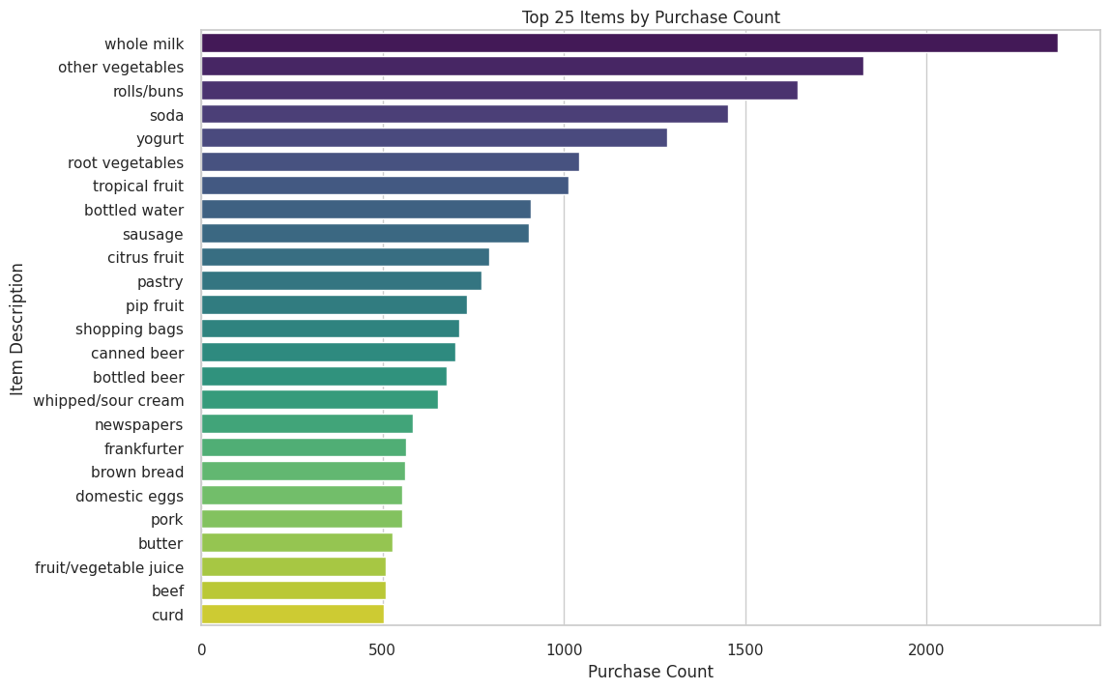
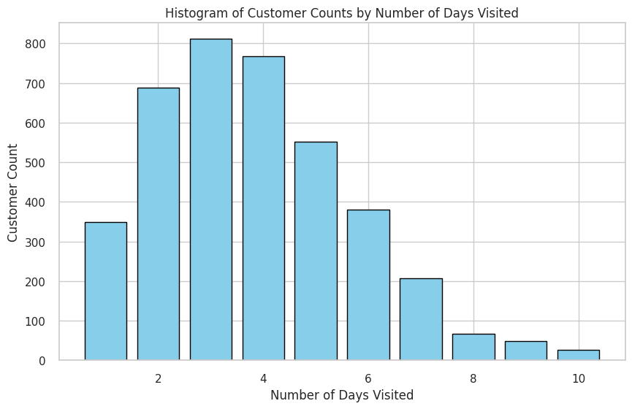
EXPLORATORY DATA ANALYSIS :
3
2
Histogram of customers count by No.of days Visited
Histogram of Customer count by Weeks Visited
Number of Users per Day visited
Top 25 Purchased Items
1
2
3
1
4
4

Slide 6
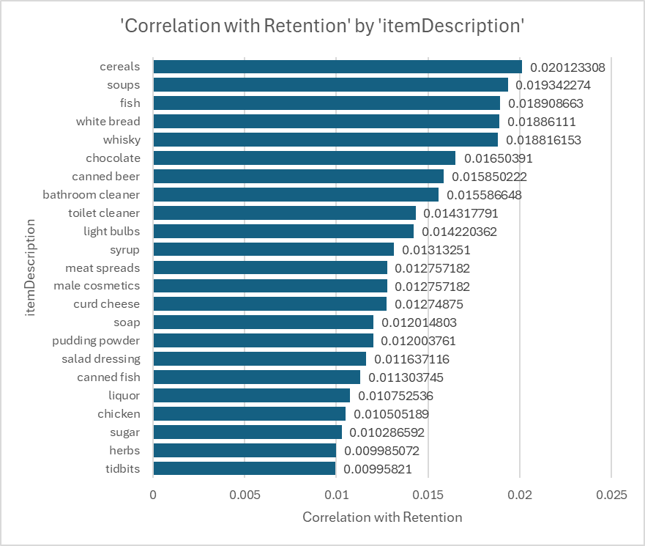
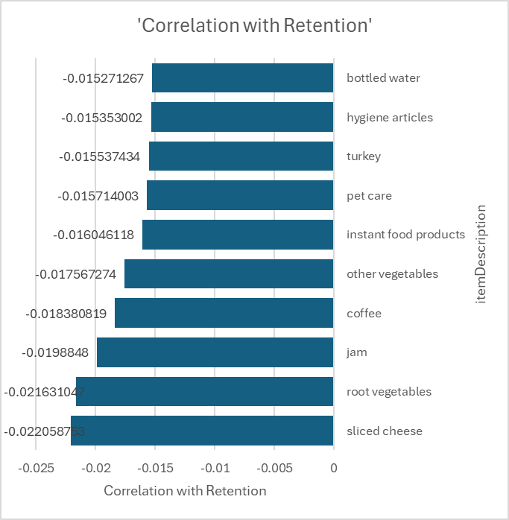
Correlation based insights
1
Returned members are buying Cereals, Soups, fish, White-bread, Whisky Items.
Churned members are buying Bottled Water, Hygiene Articles, Turkey,..
1
2

Slide 7
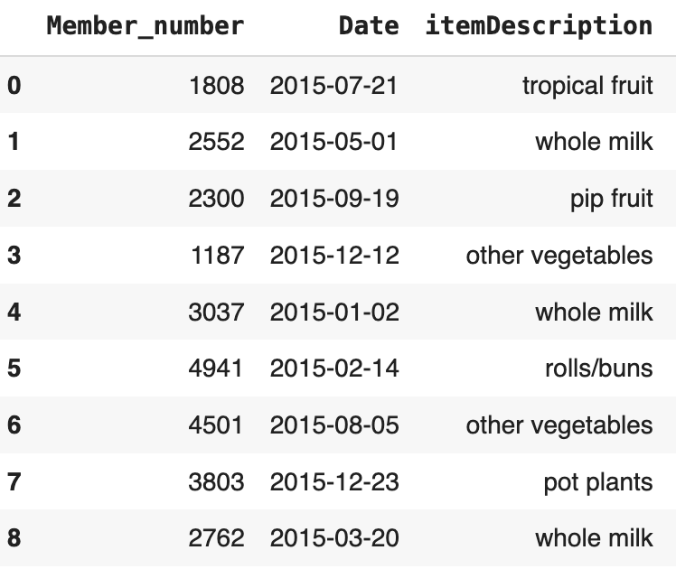
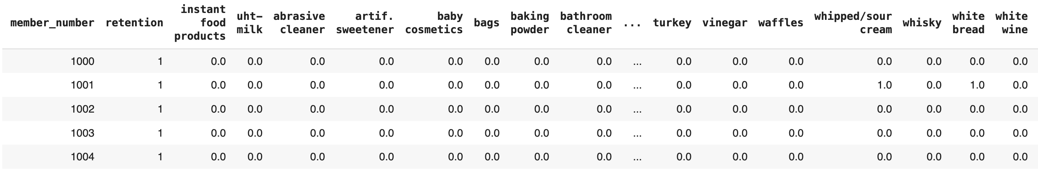
Features based data preparation
1
Target Variable
Input Features
(i.e. one product per one column)
Raw Data
Transformed the raw-data ('ItemDescriptions’, ‘Date’ and 'member_number’ columns) into the product-based input features and the retention-based target variable column for further analysis
1

Slide 8
ML based classification approach
Features preparation (including Normalization)
Train-Test split (80%-20% split)
ML model training (Boosted Decision Trees)
ML Model accuracy
ML model based important features

Slide 9
ML MODELING (XG BOOST)
XGBoost is a robust machine-learning algorithm that can help you understand your data and make better decisions.
It is widely used for tasks like classification, regression, and ranking due to features such as gradient boosting, and handling missing data.
XGBoost is used for these two reasons: Non-Linear problem, Handles Un-Normalized, and model performance.
XGBoost is a supervised learning.
We have defined our feature variables (X) by excluding 'member_number' and 'retention' columns from the dataset.
The target variable (y) is set to the 'retention' column.

Slide 10
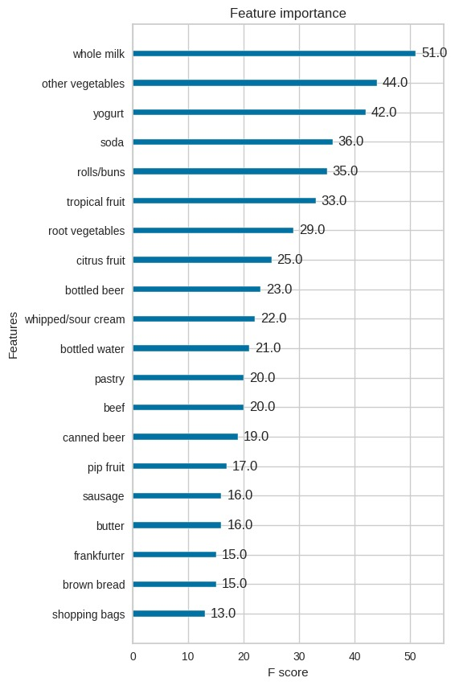
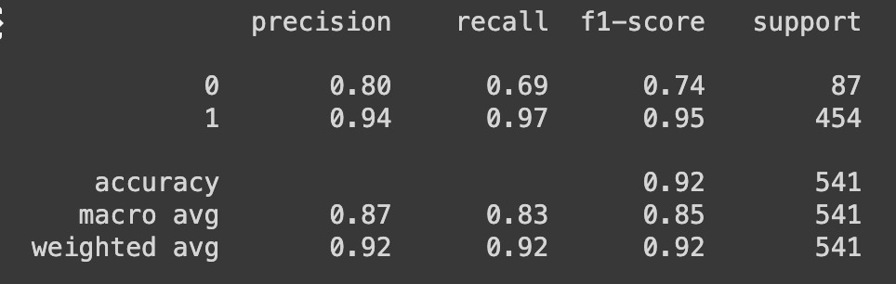
ML modellig BASED INSIGHTS
2
1
2
Boosted decision trees are used to predict whether a member is retained or churned, given the large number of available features.
Null Model accuracy 16%
This ML model accuracy is 92% (XG BOOST)
Top Important features (i.e. products) to detect the churned/returned are Whole-Milk, other-Vegetables, Soda, Rolls/buns, Yogurt
1
2

Slide 11
Apriori Algorithm-Based Frequent Sets and Association Rules
The Apriori algorithm is a data mining technique used to identify frequent item sets and generating association rules based on their occurrences.
Frequent itemset mining, specifically the Apriori algorithm, is used in supermarket-based retention analysis to identify frequent item sets and generate association rules based on their occurrences for recommendations. This can help in understanding customer behavior and preferences, and can provide insights into factors that contribute to customer loyalty or churn.
Leveraged some of R language based code from https://www.kaggle.com/code/heeraldedhia/market-basket-analysis-using-apriori-algorithm for this python code implementation
Notes:
The Apriori algorithm is one of the most widely used algorithms in data mining and is often used to extract meaningful patterns from retail transaction data. It is based on the idea that if an itemset is frequent, then all of its subsets must also be frequent. This allows the algorithm to avoid generating and testing itemsets that are unlikely to be frequent, which can greatly reduce the running time of the algorithm. The algorithm generates candidate itemsets based on the previous level and prunes them if their support is lower than a given threshold. The final output of the algorithm is a set of frequent itemsets and association rules that satisfy the minimum support and confidence thresholds.

Slide 12
Apriori algorithm based Insights
Churned Members (Retention=0)
Returned Members (Retention=1)
support | itemsets
0.197889 | (whole milk)
0.149516 | (other vegetables)
0.128408 | (rolls/buns)
0.109059 | (soda)
0.095573 | (yogurt)
0.094107 | (tropical fruit)
0.090003 | (root vegetables)
0.08971 | (sausage)
0.079449 | (citrus fruit)
0.065963 | (frankfurter)
0.064497 | (bottled water)
0.060686 | (pork)
0.060393 | (canned beer)
0.060393 | (pip fruit)
0.055116 | (pastry)
0.051891 | (bottled beer)
0.04808 | (beef)
0.047493 | (shopping bags)
0.045441 | (whipped/sour cream)
0.041923 | (curd)
0.040457 | (butter)
0.039578 | (coffee)
0.039285 | (domestic eggs)
0.038991 | (chicken)
0.038112 | (newspapers)
support | itemsets
0.353942 | (whole milk)
0.295235 | (other vegetables)
0.283891 | (rolls/buns)
0.252978 | (soda)
0.229155 | (yogurt)
0.175837 | (root vegetables)
0.172433 | (bottled water)
0.171299 | (tropical fruit)
0.144356 | (pastry)
0.140669 | (sausage)
0.139535 | (shopping bags)
0.130459 | (citrus fruit)
0.129041 | (pip fruit)
0.127623 | (bottled beer)
0.125355 | (whipped/sour cream)
0.124504 | (canned beer)
0.121951 | (whole milk, other vegetables)
0.117697 | (rolls/buns, whole milk)
0.116563 | (newspapers)
0.113443 | (brown bread)
0.107771 | (domestic eggs)
0.1038 | (fruit/vegetable juice)
0.103233 | (rolls/buns, other vegetables)
0.100964 | (butter)
0.09983 | (whole milk, yogurt)
1
Churned members are buying fewer bottled water & Pastry Items compared to retained members
Frequent Items are missing in the Top-25 list for Churned members
1
1
2
2
2

Slide 13
Apriori algorithm based Insights
antecedents | consequents | support | confidence | lift
(napkins) | (soda, frozen vegetables) | 0.005105 | 0.076923 | 3.267841
(specialty chocolate, yogurt) | (citrus fruit) | 0.005105 | 0.418605 | 3.208696
(dessert) | (sausage, brown bread) | 0.005105 | 0.071713 | 3.160757
(napkins, soda) | (frozen vegetables) | 0.005105 | 0.26087 | 3.097058
(dessert, sausage) | (brown bread) | 0.005105 | 0.346154 | 3.051346
(dessert, brown bread) | (sausage) | 0.005105 | 0.428571 | 3.046659
(yogurt, citrus fruit) | (specialty chocolate) | 0.005105 | 0.15 | 3.039655
(yogurt, beef) | (chocolate) | 0.005389 | 0.223529 | 3.019788
(tropical fruit, other vegetables) | (flour) | 0.005105 | 0.087379 | 2.962472
(curd) | (bottled water, canned beer) | 0.005956 | 0.065625 | 2.929035
1
1
Recommendations based on Returned Members (Retention=1). It is useful for arranging the products in the store or providing the offers
The algorithm works by generating a series of candidate item sets and then pruning them based on a minimum support threshold.
The support of an item set is the proportion of transactions in which it appears, while the confidence of a rule is the proportion of transactions containing the antecedent that also contain the consequent.

Slide 14
Conclusion :
Correlation based Insights
Returned members are buying Cereals, Soups, fish, White-bread, Whisky Items.
Churned members are buying Bottled Water, Hygiene Articles, Turkey,..
ML modelling based top features
Top Important features (i.e. products) to detect the churned/returned are Whole-Milk, other-Vegetables, Soda, Rolls/buns, Yogurt
Apriori Algorithm based Insights
Churned members are buying fewer bottled water & Pastry Items compared to retained members.
Frequent Items are missing in the Top-25 list for Churned members.
Recommendations based on Returned Members (Retention=1). It is useful for arranging the products in the store or providing the offers

Slide 15
References
Dataset: https://www.kaggle.com/datasets/heeraldedhia/groceries-dataset/code
Code: https://colab.research.google.com/drive/13OtbslVVUQZ62gmjyEBKf-y2R5rZ-E0u?usp=sharing
Github: https://github.com/LPrasanna0709/Data-Driven-Insights-for-Supermarket-Sales---Churn-Analysis-

